Slide 1
mCLASS®
With DIBELS 8ᵗʰ Edition
The Excellent Public Schools Act: Read to Achieve

Slide 2
The Read to Achieve program
is part of The Excellent
Public Schools Act of N.C.
(NC House Bill 950),
which became law in July 2012.

Slide 3
Goal of Legislation
All students proficient readers by the end of third grade.
Gives students multiple opportunities to show proficiency
Gives extra support to third and fourth grade students
Notes:
Goals of the legislation include that :
difficulty with reading development is identified as early as possible;
(ii) students receive appropriate instructional and support services literacy interventions to address difficulty with reading development and to remediate reading deficiencies; and
(iii) each student and his or her parent or guardian be continuously informed of the student's academic needs and progress."

Slide 4
KEY QUESTIONS
What steps are being taken to get your 3rd-grader reading at or above grade level?
How will the State determine if your child is reading at or above grade level?
What will happen if your child isn’t reading at or above grade level?
How can you help your child with his or her reading?

Slide 5
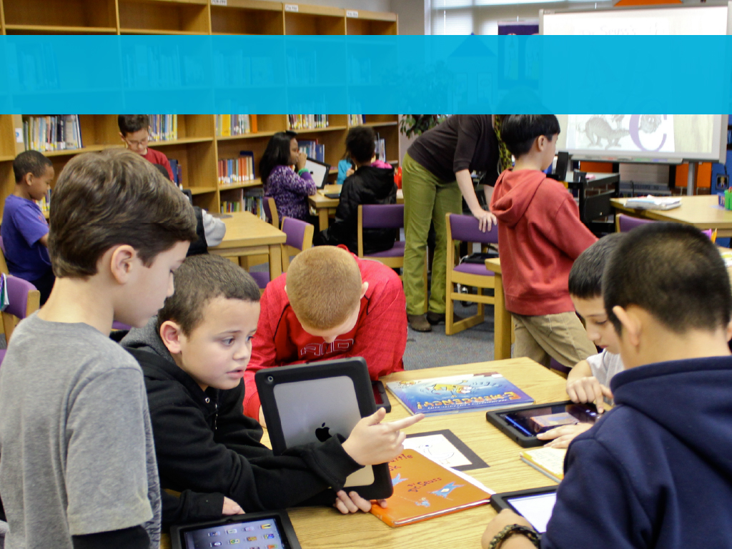
What steps are being taken to get your 3rd grader reading at or above grade level?
We are providing strong instruction in literacy.
Notes:
Strong core instruction Aligned with the Science of Reading

Slide 6
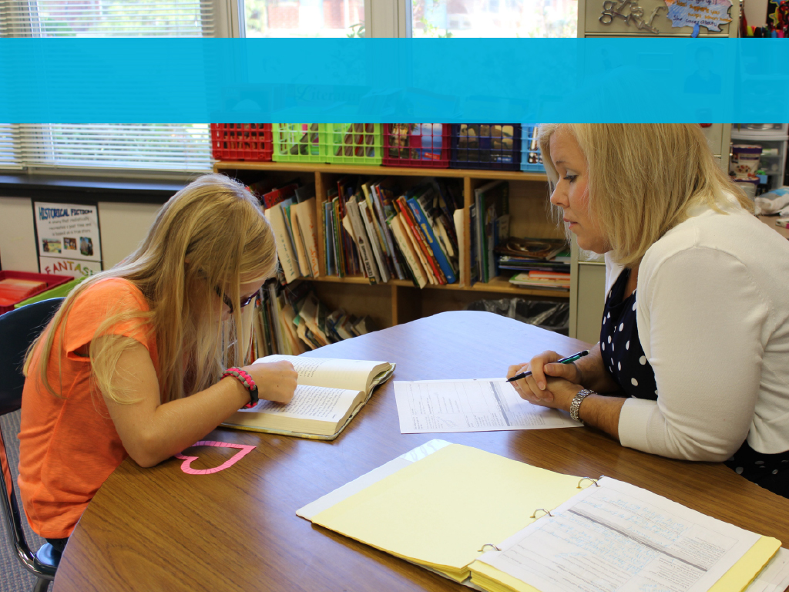
What steps are being taken to get your 3rd grader reading at or above grade level?
We are providing extra help to students who need it.
Notes:
Strong supports in response to literacy data.

Slide 7
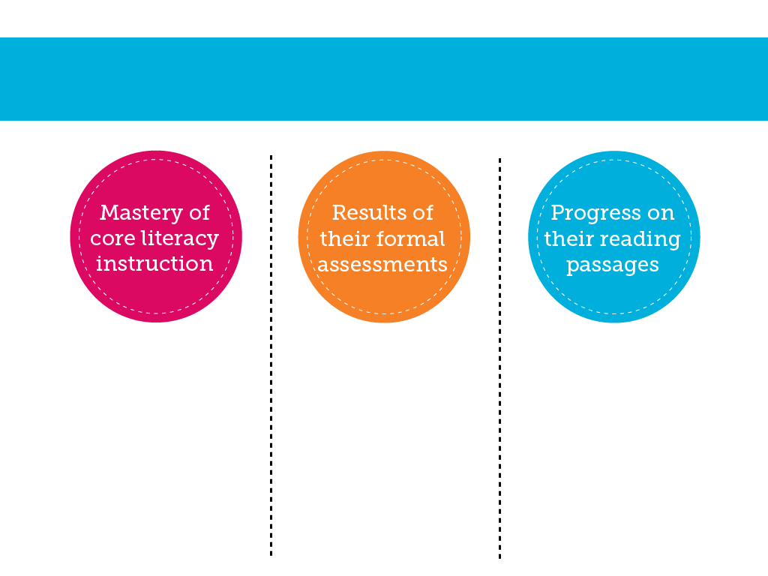
What steps are being taken to get your 3rd grader reading at or above grade level?
We are gathering information on your child’s progress.
Your child’s teacher will continue to observe and monitor their progress.
These assessments include the mClass DIBELS 8 Assessment along with the EOG.
Students have an opportunity to demonstrate proficiency on passages aligned with the standards.

Slide 8
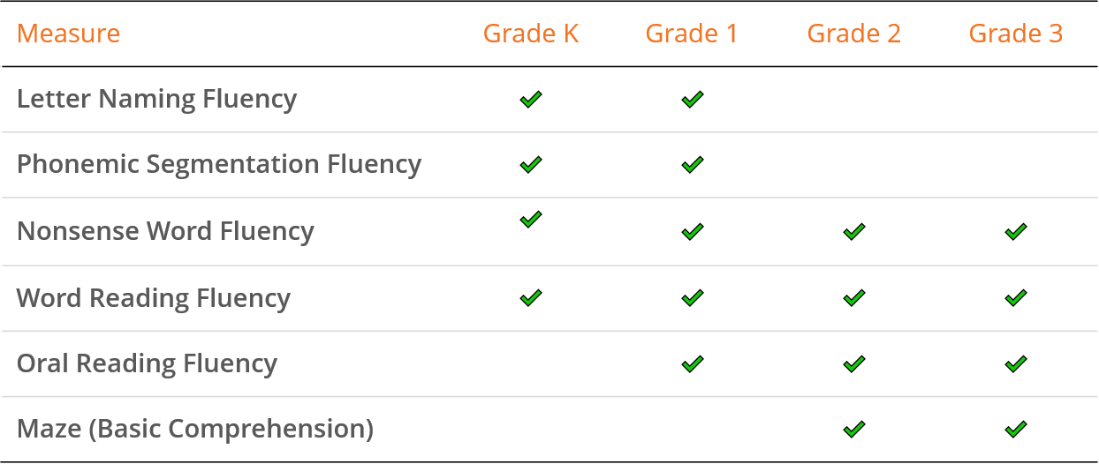
What is mClass DIBELS 8?
Dynamic Indicators of Basic Early Literacy Skills
Phonemic awareness
Alphabetic principle
Decoding skills
Accuracy and fluency in text
Notes:
DIBELS 8th Edition is a set of short (one minute) fluency measures that can be used for universal screening, benchmark assessment, and progress monitoring in Kindergarten to 8th grade. DIBELS 8th Edition provides educators with standards for gauging the progress of all students.
*According to our Read to Achieve legislation: All Kindergarten, first, second, and third grade students shall be assessed with valid, reliable, formative, and diagnostic reading assessments

Slide 9
What steps are being taken to get your 3rd grader reading at or above grade level?
We are sharing information on your child’s progress.
We’ll talk about this specifically during conferences, emails, or reports home.
You will get formal reports, including the Home Connect Letter.
We’ll share standards and scores.

Slide 10
The law outlines that if a 3rd-grader
is NOT reading at grade level by the
end of Grade 3, they will be encouraged to attend a free, district-sponsored reading camp, offered for at least 72 hours, to receive additional reading support.
Notes:
The current bill expands the definition for the Read to Achieve summer reading camps for third graders to include any second or first grader demonstrating difficulty with reading development. The summer camps are not mandatory and parents make the final decision on attendance.
Data will continue to be collected through TRC, EOG and Read to Achieve test (if needed).
If the student begins reading camp and then qualifies for a good cause exemption, they no longer need to attend camp but have the option to continue.
If questions about camp attendance come up: “Attendance is strongly encouraged so that your child will continue to receive additional instruction and support in the areas of reading.” (There is no formal attendance policy)

Slide 11
Students will be invited to attend the reading camp during the summer, if they do not pass the Reading EOG or qualify for a good cause exemption.

Slide 12
YEAR ROUND CALENDAR STUDENTS
How will the State determine that your child is reading at or above grade level?
Good cause exemptions include any student who:
demonstrates proficiency on Read to Achieve Test
is a Limited English Proficient (LEP) student with fewer than two years of instruction in the ESL program
has a disability and whose individualized education program (IEP) indicates (i) use of the NCEXTEND 1 alternate assessment, (ii) at least a two-school-year delay in educational performance or (iii) receipt of intensive reading interventions for at least two school years
has (i) received reading intervention and (ii) previously been retained more than once in kindergarten or Grades 1 through 3
demonstrates reading proficiency appropriate for 3rd-grade students on approved alternate assessments approved by the State Board of Education
Notes:
The local alternative assessment includes the Dibels 8 assessment.

Slide 13
YEAR ROUND CALENDAR STUDENTS
If your child is determined to be reading below grade level, you have two choices:
Attend Camp
Decline Camp
Your child will be retested at the end of camp and move into the 4th grade if proficient.
Children who are still not reading at grade level will have a ‘retention designation’ and receive additional support in 4th grade.
The retention designation will be removed if the child demonstrates proficiency by mid-year of 4th grade.
Your child will have the opportunity to take an assessment on a designated date and time.
Students who are not proficient based on the assessment will have a ‘retention designation’ and receive additional support in 4th grade.
The retention designation will be removed if the child demonstrates proficiency by mid-year of 4th grade.
Notes:
If you would like to highlight the advantages of attending camp, share the following information:
Data will continue to be collected through TRC, EOG and Read to Achieve test (if needed).
If the student begins reading camp and then qualifies for a good cause exemption, they no longer need to attend camp but have the option to continue.
If questions about camp attendance come up: “Attendance is strongly encouraged so that your child will continue to receive additional instruction and support in the areas of reading.” (There is no formal attendance policy)
If questions are asked about how this looks in 4th grade, information will be shared with parents as it applies.

Slide 14
How can I help my child with his or her reading?
Read together for at least 20 minutes each day!
Parent/Teacher Communication
Visit the library
Stay involved
Notes:
20 minutes of daily reading – underscore importance of reading a variety of texts. A balance of information and literature.

